Slide 1
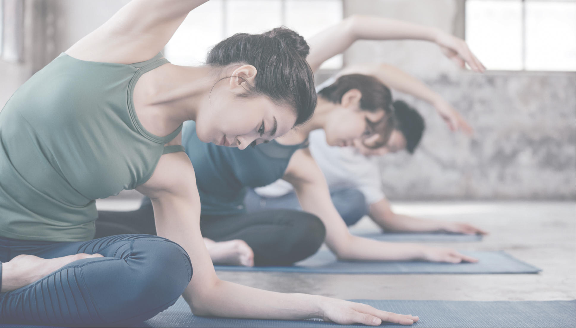


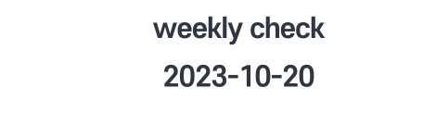
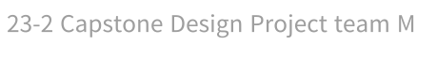
Notes:
Hello, I’m Jaehyun Song from team M, we changed presenting date with team F for this second weekly check.
It feels like our team always get some time limit, so I’ll try to get to the point on every slide.

Slide 2
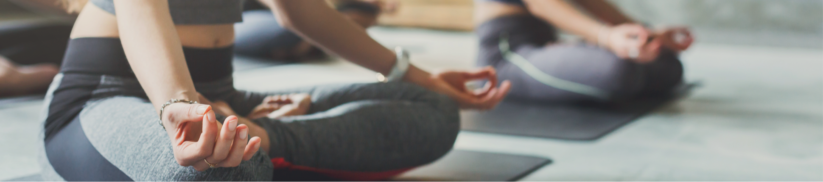

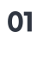
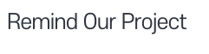
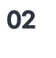
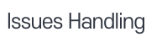
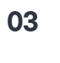
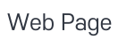
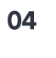
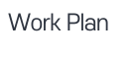
Notes:
For our second presentation, I’ll recap our progress till last weekly check, go through issues we’ve handled and website we started to develop.

Slide 3

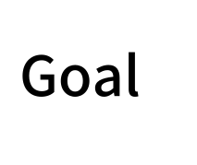

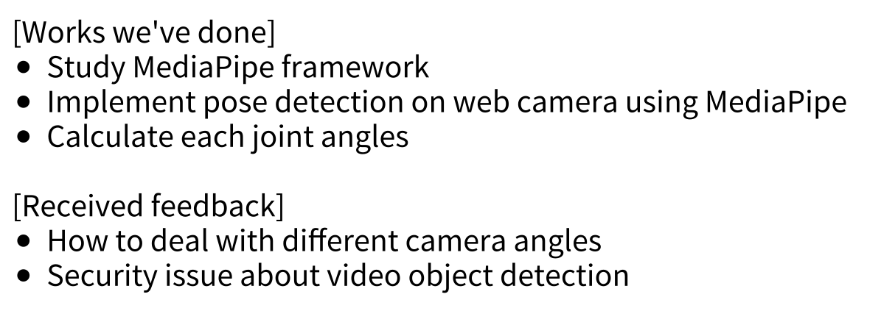
Notes:
Our object is to build a yoga pose correction AI web service using pose estimation model.
Until last weekly check, we studied mediapipe framework which was a pose estimation module provided by Google.
Then we implemented it on web camera and developed joint angle calculating function.
We got two feedback from it. One was how to deal with different camera angles and one was security concern due to webcamera video data.

Slide 4

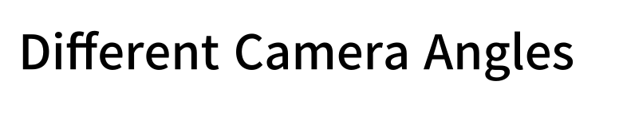
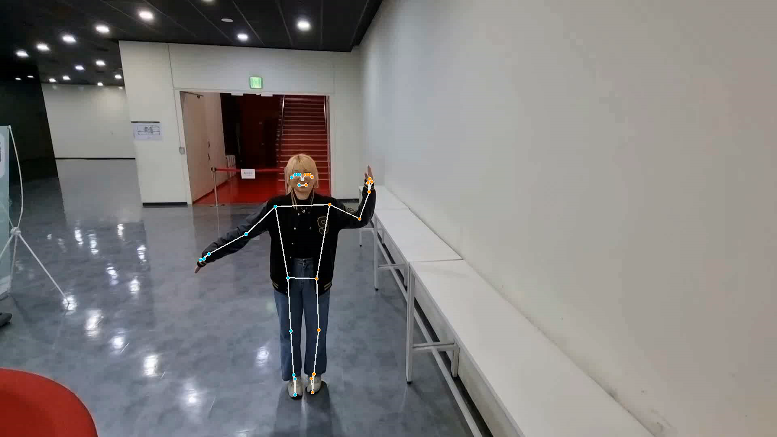
Notes:
We had a few feedback and concerns about different camera angle.
So we actually tested about this issue.
We tested same pose with changing angle , and tracked how the joint angles differ.
This is the video and estimated pose over it.
클릭
I did this random pose which I thought makes many angles and we shoot it from high above to the floor.
You can see that it keeps track on the pose eventhough there’s some interruption such as finger.
we managed to keep track of estimating pose rather than giving the error.

Slide 5
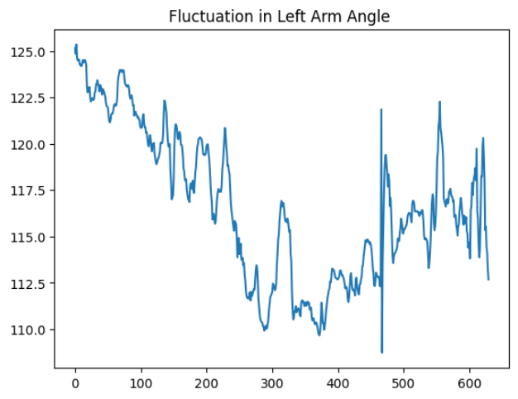

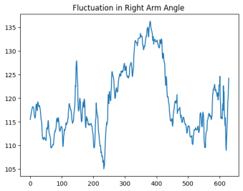
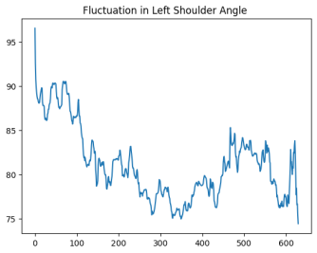
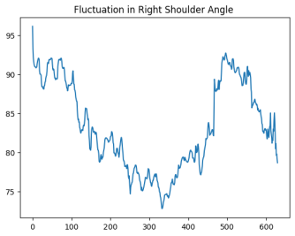
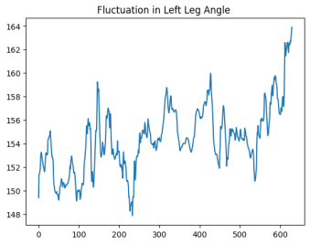
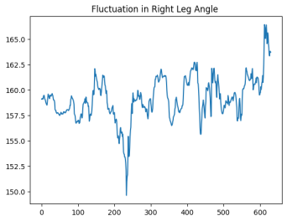
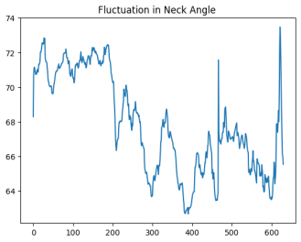
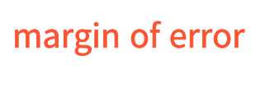
Notes:
This is the results of the test. Each plots give the value of each joint angles regarding to the changing cameara angle.
Everyone can tell that the joint angle does change when the camera angle changes.
But fortunately, margin of error isn’t so big. You can see the range of the value on the y-axis. In this test video, we can say that this range can be the margin of error.
It had mostly 10 to 15 degree of margin of error, and considering the range of our camera angle we have changed, it’s even better than expected.
Through this test, we thought that if we let user adjust camera roughly, camera angle shouldn’t be an issue.

Slide 6
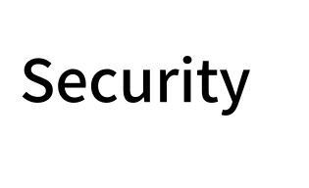
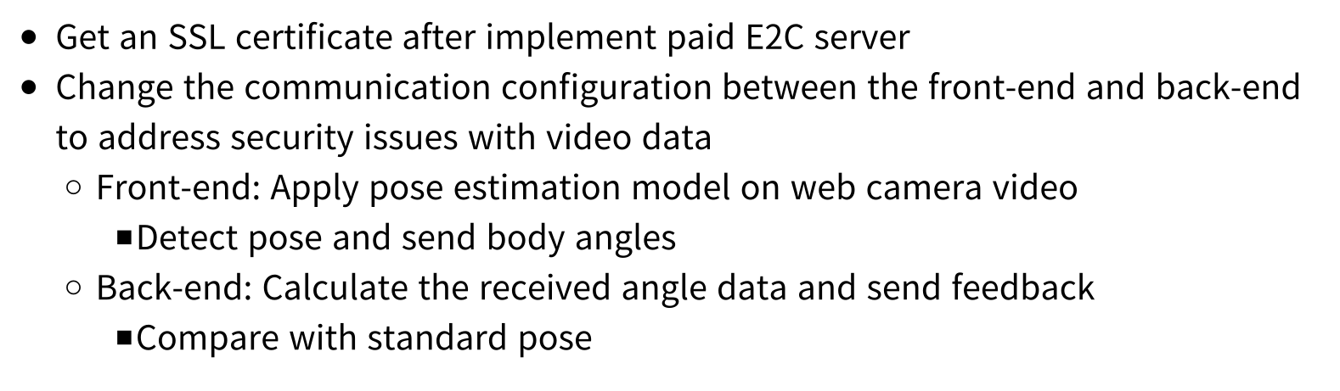

Set
Notes:
Next feedback was about security of video data.
First of all, we are going to get an SSL certificate to our website, so overall privacy is guaranteed.
And about sending data to server or BE kind of issue, we searched about it to make it secure enough.
To secure video data, we are planning to apply pose estimation model on FE. We will detect body and calculate joints angle on the front end.
Then on the backend side, it will request for joint angles. It will compare with the correct poses’ angle and make appropriate feedback from the comparison result.
By this configuration, we believe that the privacy issue would be solved.

Slide 7

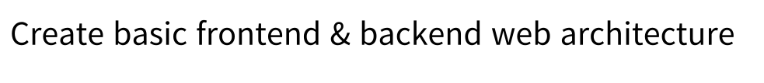



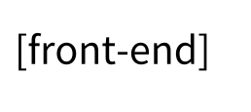
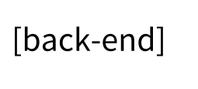
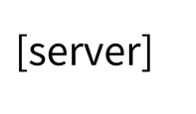
Notes:
After handling issues we’ve got from last week’s feedback, we started to build our web application this week.
We’re using react, spring boot, and aws for our website.

Slide 8
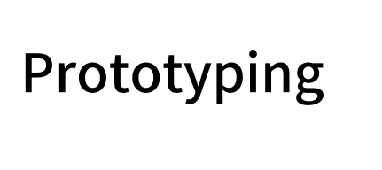
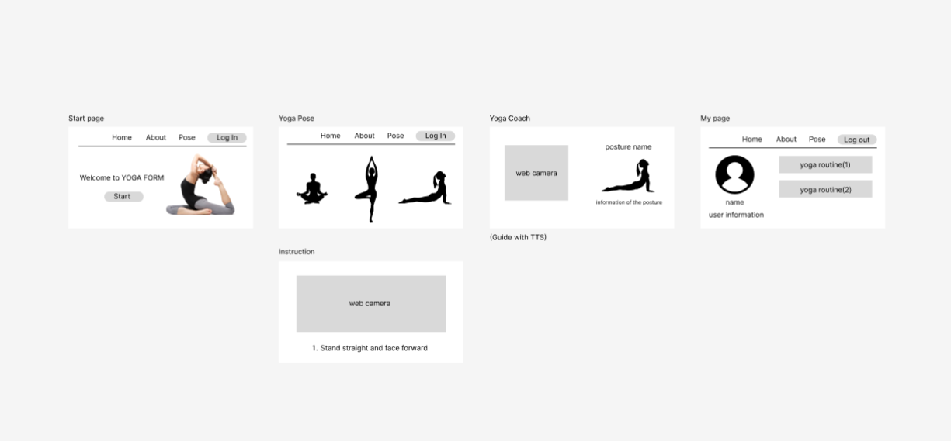
Notes:
We were also designing UI and this is our ongoing prototype design.

Slide 9

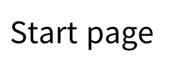
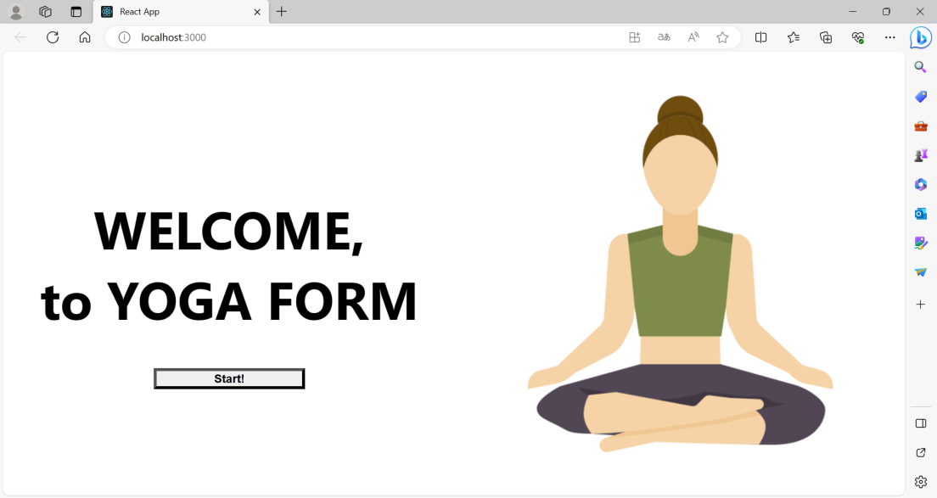
Notes:
This is our very rough homepage built by react. We discussed about the usecase of our website and made homepage as a start.

Slide 10
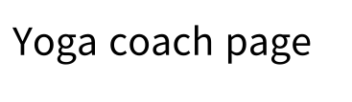
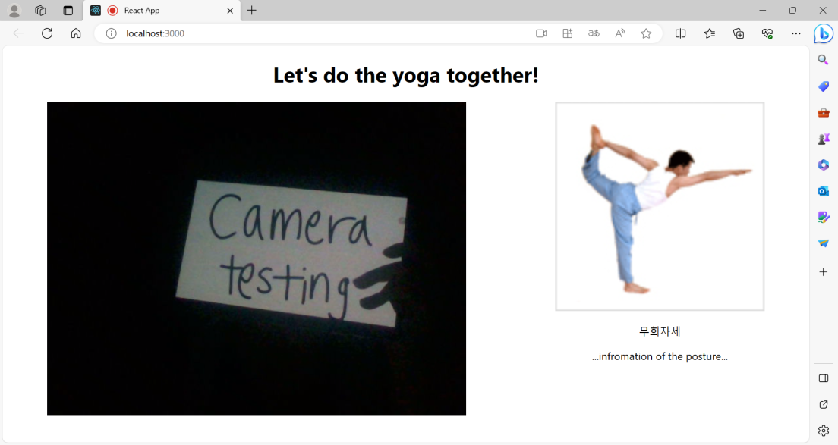
Notes:
Also we made yoga page and tested if web camera works well.
Fortunately, you can see that it worked well.

Slide 11
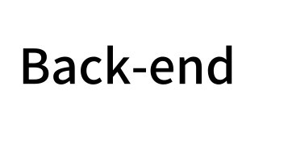
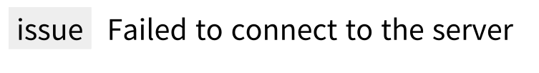
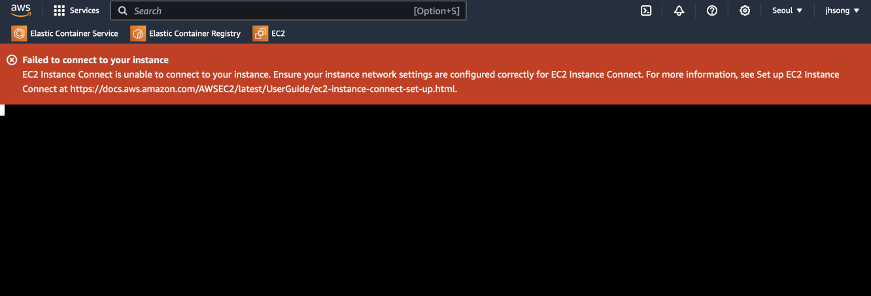
Notes:
About backend, we opend aws ec2 instance and initialized spring boot project.
However our instance was a free model, which allows small cpu and when we started to run the program it crashed.
We’re waiting for the support fund for this class, so that we can get larger instance to build BE.
We searched about SSL certificates too so after reopening new instance, we’ll set the backend as fast as we can.

Slide 12

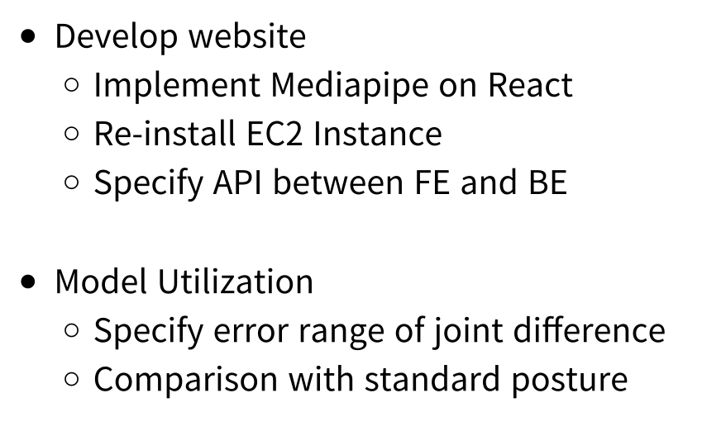
Notes:
Until midterm presentation, we’re planning to develop website and make comparison function.

Slide 13
